Slide 1
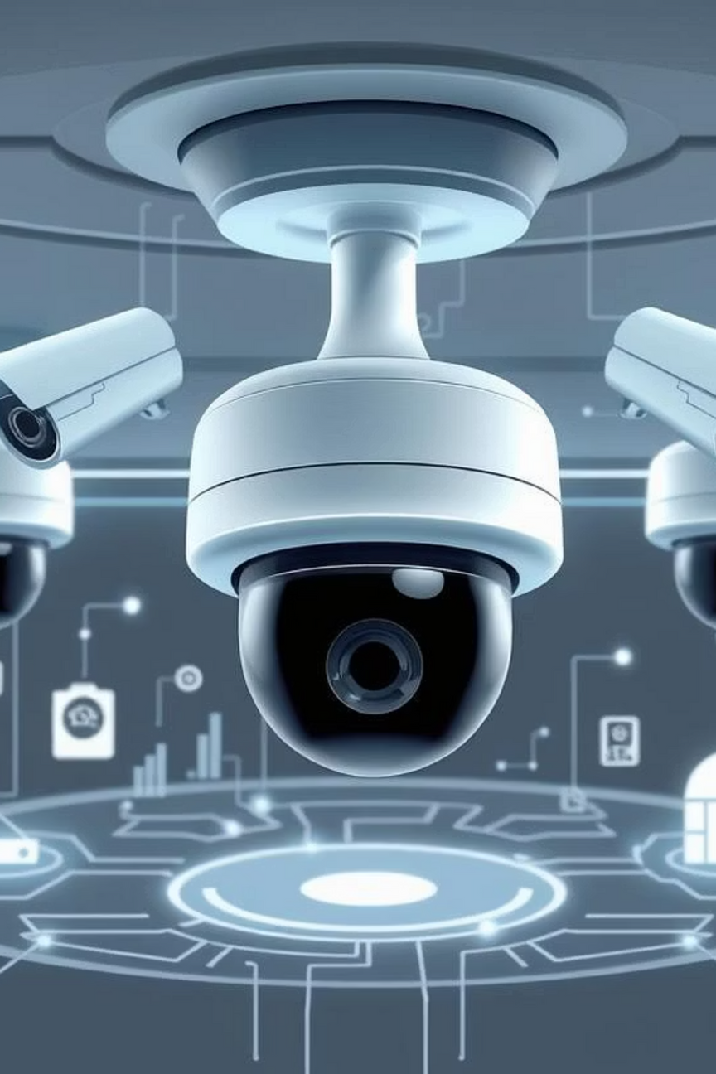

ASHOKRAO MANE GROUP OF INSTITUTIONS, VATHAR
Vision Guard :
AI-Based Surveillance System
Presented By :
Roll No. 01 – Om Ambekar
Roll No. 03 – Roshan Bhatale
Roll No. 22 – Shivprasad Mali
Under the Guidance of : /Prof. P. R. JADHAV
Academic Year 2024-25
Notes:
1

Slide 2
Abstract :
In an era marked by escalating security concerns, the demand for intelligent surveillance systems has grown exponentially. Traditional CCTV setups, heavily reliant on manual human monitoring, often prove inefficient and slow in responding to critical situations. Our project, Vision Guard: AI-Based Surveillance System, addresses these limitations by proposing a robust desktop-based application.
Developed with PyQt5 for a responsive frontend, Flask for a powerful backend, and Microsoft SQL Server for secure data management, Vision Guard offers an automated solution. Key features include real-time streaming from webcams and IP cameras, automatic face detection leveraging advanced AI algorithms, and instantaneous criminal identification against a pre-saved database. Crucially, the system sends immediate Telegram alerts upon detection, complete with pertinent details. Additionally, it provides a user-friendly interface for seamless management of criminal and authorised personnel profiles. This project significantly contributes to automating security monitoring, minimising human errors, and drastically reducing response times in emergency scenarios.
Notes:
2

Slide 3
Introduction :
Importance of Surveillance
Ensuring public safety in offices, schools, banks, and public areas is paramount.
Limitations of Traditional Systems
Current CCTV relies on human monitoring, leading to delayed responses and post-incident reviews.
AI's Transformative Role
Artificial Intelligence enables automatic detection, recognition, and alert generation.
Need for Real-time Identification
Crucial for crime prevention and rapid response to emerging threats.
Introducing Vision Guard
Our proposed AI-based system automates surveillance with integrated notification for enhanced security.
Notes:
3

Slide 4
Literature Survey :
No.
System / Technique
Limitation
1
Traditional CCTV
Manual monitoring, time-consuming, error-prone.
2
Face++ API (cloud-based)
Requires constant internet access, privacy concerns.
3
OpenCV +
Poor accuracy in low-light conditions and varying angles.
4
Telegram API
(prior projects)
Lack of integrated real-time video processing.
5
Proposed – Vision Guard
Offline functionality, real-time local AI recognition & instant alerts.
Our research explored existing solutions, from basic CCTV to advanced cloud-based AI systems. We identified significant gaps in local, real-time criminal identification with instant, private alerts. This informed our design choices, focusing on a robust, offline-capable solution using OpenCV, Flask, and PyQt5.
Notes:
4

Slide 5
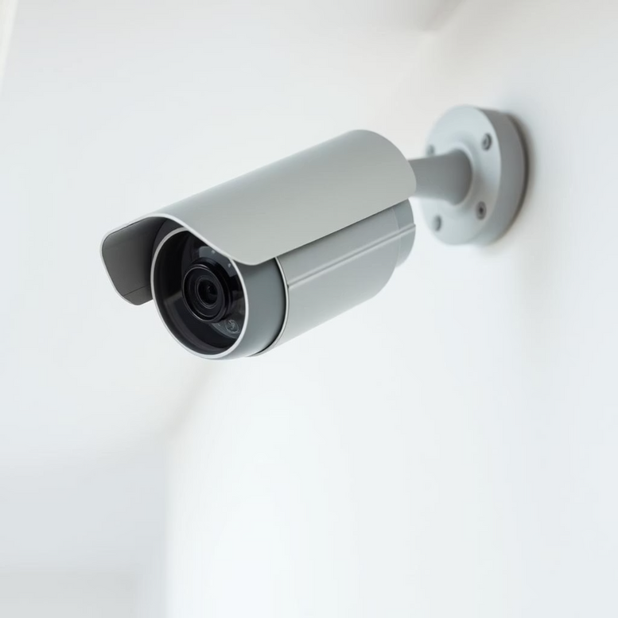
Existing System :
Manual Monitoring : Current CCTV systems demand constant human vigilance, which is exhaustive and often ineffective.
Human Error & Negligence : Prone to missed threats and delayed responses due to human fatigue or oversight.
Post-Incident Review : Footage is typically reviewed only after an incident occurs, making proactive prevention impossible.
No Automatic Detection : Lacks integrated criminal face detection or automated alert mechanisms.
Lack of Integration : Poor or no integration with modern emergency communication tools like Telegram.
Inefficient & Non-Adaptive : Traditional systems are not intelligent, struggling in dynamic or crowded environments.
Traditional CCTV setup, highlighting manual operations.
Notes:
5

Slide 6
Problem Statement :
In many security-sensitive areas, traditional surveillance systems fall short in providing real-time threat detection and timely alerts. These systems rely heavily on human monitoring, which is slow, prone to error, and inefficient in high-risk scenarios.
1
2
Automated Identification
Response Delay
Existing CCTV systems lack automated criminal identification capabilities.
Manual footage review causes significant delays in security response.
3
4
No Instant Alerts
Inefficient Coverage
Absence of instant alert mechanisms to notify security or authorities.
Surveillance is inefficient in high-traffic or remote areas without automation.
Notes:
6

Slide 7
Proposed Work :
The proposed system, Vision Guard, is a smart surveillance application designed to automate criminal detection using face recognition
Desktop GUI
Live CCTV Feed
Face Recognition
Developed using PyQt5 for a real-time, interactive user interface.
Enables integration with webcams and IP cameras for live monitoring.
Implements advanced AI for identifying known criminals.
SQL Server Database
Flask Backend
Telegram Alerts
Connects for secure management of user and criminal profiles.
Utilised for seamless communication and data handling.
Triggers instant notifications with full criminal details upon detection.
Modular Design
Ensures easy expansion, maintenance, and future upgrades.
Notes:
7

Slide 8
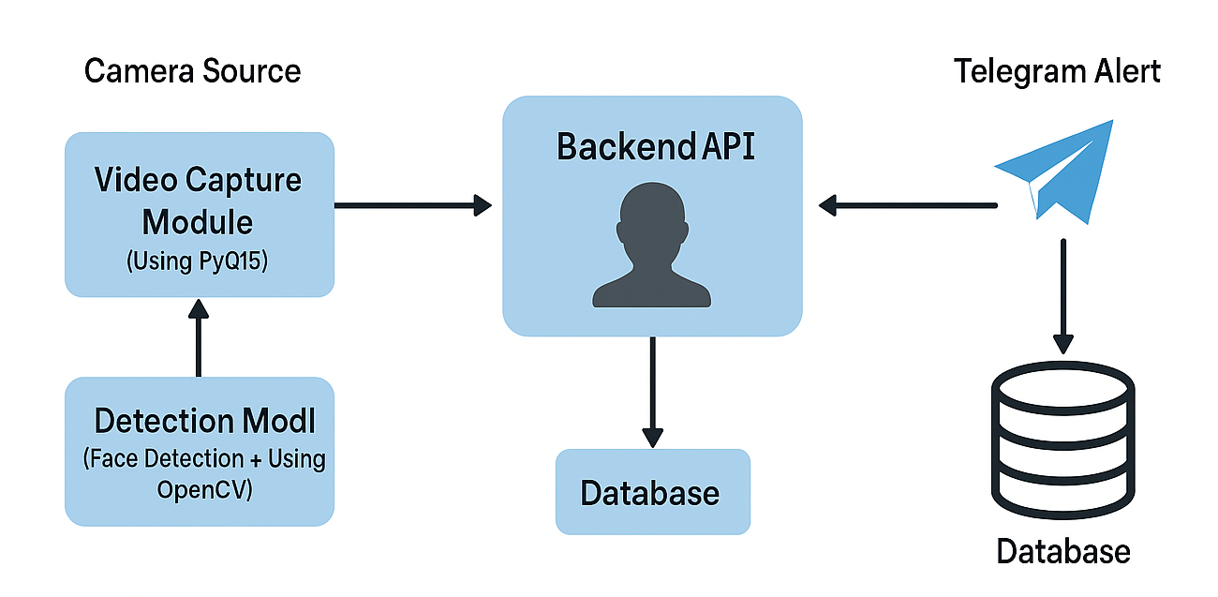
System Architecture of Vision Guard
Notes:
8

Slide 9
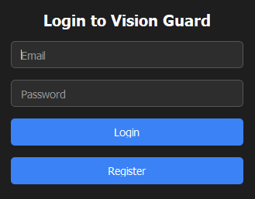
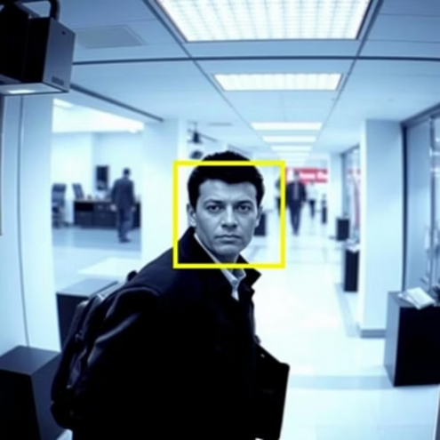
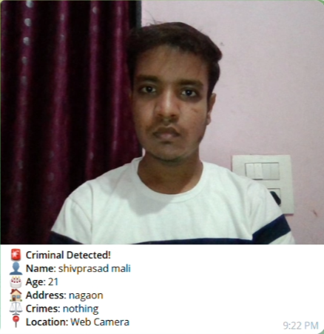
Methodology
Algorithms/Technologies
Live video stream capture from cameras.
Face Detection : CNN-based : face_recognition).
Frame extraction and face detection using OpenCV.
Face Encoding : 128-dimension face vector comparison.
Encoding of known criminal images.
Video Processing : OpenCV for frame capture.
Real-time comparison of detected faces
Telegram Bot : Python Telegram API for alert messaging.
Fetching criminal details from SQL Server upon match.
Frontend : PyQt5 for robust desktop GUI development.
Sending immediate Telegram alerts.
Backend : Flask for efficient API routing.
Screenshots
Notes:
9

Slide 10
Requirements :
Software Requirements
Hardware Requirements
Operating System : Windows 10 or later
RAM : Minimum 8 GB
Programming Language : Python 3.8+
Processor : Intel i5 or higher
Frameworks : PyQt5 (GUI), Flask (backend API)
Camera : Webcam or IP Camera
Libraries : OpenCV, face_recognition , requests.
Connectivity : Stable internet connection
Database : Microsoft SQL Server
Storage : 500 GB HDD or SSD
Other Tools : Telegram Bot API
Notes:
10

Slide 11

Vision Guard
: AI-Based Surveillance System
Vision Guard is an innovative AI-based surveillance system designed to enhance security, usability, and efficiency by leveraging real-time criminal detection and instant alerts.

Slide 12
Advantages :
Real-time Detection
Instant Alerts
Provides real-time criminal detection using AI-based face recognition.
Sends instant Telegram alerts to security personnel with
full details.
Reduced Monitoring Effort
Versatile Camera Support
Minimises human monitoring effort and reduces fatigue-related errors.
Works with both webcams and IP cameras for flexible
deployment.
Desktop-Based System
User-Friendly GUI
Fully desktop-based system, with no dependency on cloud.
Easy-to-use graphical interface for non-technical staff.
Secure Record Keeping
Scalable Future Growth
Allows secure storage and retrieval of criminal records.
Scalable to add more cameras or alert channels in the future.

Slide 13
Future Scope :
Mobile Application
4
Multi-Camera Dashboard
1
App version for real-time alerts on smartphones.
Support multi-camera dashboard.
2
Law Enforcement Integration
5
Behavioral Analysis
Integrate with law enforcement databases
ML-based behavioral analysis
Voice & Alarm Integration
6
Access Control Integration
3
Add access control integration
Add voice alert or alarm integration

Slide 14






Limitations :
Internet Dependency
Lighting & Crowd Impact
Requires stable internet connection to send
Telegram alerts.
Face recognition accuracy may decrease in poor lighting or crowded backgrounds.
Known Database Limited
Desktop-Only
Limited to known criminal database
– cannot identify unknown threats.
Desktop-only solution – no mobile version available.
Processing Load
Telegram-Only Alerts
Real-time processing load may affect performance on
ow-end systems.
Alerting limited to Telegram – no multi-channel support yet (e.g., SMS, email).

Slide 15
THANK YOU…!

